Slide 1
Using R to Tidy your Data
Brian Pattiz
University of Denver

Slide 2

Presenter
Brian Pattiz
Research Analyst
University of Denver
Office of Institutional Research and Analysis

Slide 3
Introduction
Prerequisites
This workshop is designed for R users with some experience and knowledge of the basics
Data structures
Iterative programming
Dataframes
What you will learn
How to import data from various formats into R
Data exploration and wrangling with Tidyverse package suite
How to work more efficiently using functional programming techniques
Working fast and efficiently to model data

Slide 4
Workshop Materials
https://github.com/bpattiz/AIR-Forum-2019-Workshop

Slide 5
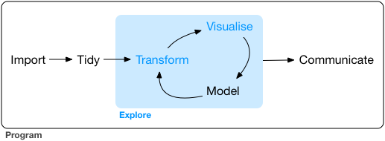
Data Analysis Flow Chart
From R for Data Science

Slide 6

What is the Tidyverse?
The Tidyverse is a suite of R packages that follow the same design philosophy used for data tasks:
Importing
Manipulation
Exploration
Visualization

Slide 7
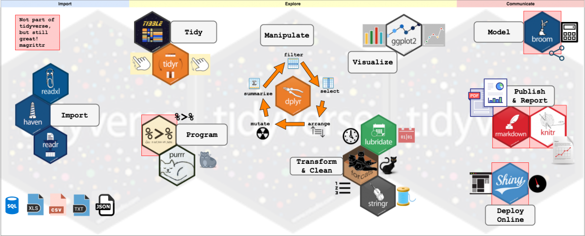

Slide 8

tibbles: data frames of the Tidyverse
Tibbles are the modern version of data.frame from Base R
They include the best features from that function and get rid of the features that cause problems
The input type is never changed
Friendly use of list-columns
row.names are violation of the tidy data philosophy, thus are not used
Only vectors of length one are recycled
Printed output is much more user friendly
Data types of subsetted data are consistent

Slide 9

Importing rectangular data
readr is a fast, reliable package that parses flat files into data frames:
read_csv() parses comma delimited files; read_csv2() parses semicolon separted files
read_tsv() will read tab delimited files; read_delim() parses any delimited file
read_fwf() parses fixed width files and read_table() is for a fixed width file separted by white space
read_log() parses log files. The package webreadr provides many tools for reading different log files

Slide 10

Importing Excel formatted files
readxl is a package to to parse Excel formatted files into data frames
The advantage this package has over others is that it has no external dependencies such as Java
The package can handle both legacy formats such as .xls and the xml-based .xlsx
read_excel() is generic function used to import these files
readxl has no write capabilities. openxlsx is a package useful for this.
The package tidyxl can import non-tabular data from Excel files into R

Slide 11

Importing SAS, SPSS, and Stata formatted files
haven is a package allows you to import and export data in SAS, SPSS and Stata formats
SAS binary files (SAS7BDAT), including compressed files and transport files are parsed with read_sas() and read_xpt()
SPSS files .sav, .zsav and .por can be read with read_spss()
STATA formatted .dta can be read with read_stata()

Slide 12
Working with internet data formats
Introduction to APIs
Advanced Programming Interfaces (APIs) is a set of procedures that makes a website’s data be read by a computer
Servers are computers that can process APIs
Clients are programs that helps users access data from a server through an API
HTTP
Request
Response

Slide 13

R Packages for internet data
httr: A package to communicate with APIs
jsonlite: A JSON parser
xml2: XML parser and functions to make working with XML easier
rvest: Webscrapping with R, works as a wrapper for httr and xml2
Useful httr functions
GET(): HTTP verb get
response(): The response object that captures information from a request
headers(): Response headers
content(): Retrieves the contents of a request

Slide 14
JSON format
JavaScript Object Notation is a data format with the following features:
Lightweight
Easy for humans to read and machines to parse
Text format independent of any programming language
Structures: Collection of name/value pairs and an ordered list of values
Takes on the form of an object, array, value, string and number
{"universities":[ {"unitid": "127060", "instnm": "University of Denver"}, {"unitid": "126678", "instnm": "Colorado College"}, {"unitid": "126614", "instnm": "University of Colorado Boulder"} ]}

Slide 15
XML format
Extensible Markup Language is a data format with the following features:
Human and machine readable
Text format independent of any programming language
Markup language similar to HTML
Basic unit of data is an element, delimited by tags
XML Trees are hierarchical structures of elements with a single root element and its children elements

Slide 16
XML example
<universities> <university> <unitid>127060</unitid><instname>University of Denver</instname> </university> <univerisity> <unitid>126678</unitid><instname>Colorado College</instname> </university> <university> <unitid>126614</unitid><instname>University of Colorado Boulder</instname> </university> </universities>

Slide 17
Useful R functions for parsing XML, HTML and JSON
jsonlite
fromJSON(): Convert JSON objects to R
toJSON(): Convert R objects to JSON
xml2
read_xml(): Read XML
xml_find_all(): Extract nodes from locations in the XML document
xml_text(), xml_double(), xml_integer(): Extracts text and numeric attributes
rvest
html_node(): Extract elements out of HTML documents
html_text(), html_attrs(), html_name(): Extract text, attributes and tags from HTML documents
html_table(): Reads HTML tables into dataframes

Slide 18
Tidy Data Philosophy
Wickham (2014) defines tidy data as:
1. Each variable forms a column.
2. Each observation forms a row.
3. Each cell will contain its own value

Slide 19

Piping
The pipeline operator %>% from the magrittr package is used to string together multiple functions in a sequence of operations.
Eliminates the need to create multiple objects
Makes code very easy to write and read
Easy to go back and add to the sequence of operations
x %>% f(x, y) %>% f(x,y,z)

Slide 20

dplyr: A Grammar of Data Manipulation
verbs
select() allows you to choose the variables based off their names or data type
filter() subsets the data based on values
mutate() creates new column(s)
arrange() will manipulate row ordering
summarise() reduces the dimension of the data to summary values

Slide 21
select
df %>% select(…)

Slide 22
select
select(df, ...) extracts columns into a data frame
pull(df, ...) extracts column values into a vector
rename(df, ...) renames columns
Helper functions
contains(match)
matches(match)
starts_with(match)
num_range(prefx, range)
one_of(...)
everything(...)
group_cols(vars)

Slide 23
filter
df %>% filter(…)

Slide 24
filter
filter(df, ...)subsets data by extracting rows that meet a logical expression
distinct(df, ..., keep_all = FALSE) removes rows with duplicates
slice(df, ...) selects rows by positions
Boolean Operators to use with filter
<, <=, >, >=, is.na(), !is.na(), %in%, !, |, &, xor

Slide 25
mutate
df %>% mutate(…)

Slide 26
summarise
df %>% summarise(…)

Slide 27
Summarise by Group
df %>% group_by(column) %>% summarise(…)

Slide 28
functions for summarise
tally(): short hand for summarise(n = n())
group_by(): Returns the same tibble, only grouped by a column(s)
count(): is eqivalent to df %>% group_by() %>% summarise()
add_tally(): is equivalent to df %>% mutate(n = n())
add_count() is equivalent to df %>% group_by() %>% add_tally()

Slide 29
arrange
df %>% arrange()

Slide 30
dplyr verb extensions
*_all(df, .funs): Apply a function to every column
*_at(df, .funs): Apply a function to specific columns
*_if(df, .funs): Apply a function to all columns that meets a condition

Slide 31
Combine Data by Rows and Columns
df %>% bind_rows(df2)
df %>% bind_cols(df2)

Slide 32
Combine Data by Joins
dplyr provides a family of functions to join together two dataframes with the *_join family of functions
Mutating joins: Combine variables from two dataframes
Filtering joins: Keeps rows from the left dataframe based on matching values from the right dataframe
Nested joins: Return the left dataframe and add a list column of rows from the right dataframe that matches the left

Slide 33

tidyr: tools to create tidy data
tidyr provides functions that help make messy data fit into the tidy data philosophy.
pivot_longer(), also known as gather() takes columns and makes data longer by gathering them into key-value pairs
pivot_wider(), also known as spread() takes unique values of two columns, a key-value pair, makes data wider by spreading it over multiple columns
separate() is used to take a column that contains multiple variables into separate columns
unite() will take multiple variable values and combine them into one column
nest() will nest columns inside a dataframe creating list columns.

Slide 34
pivot_longer (gather)
df %>% pivot_longer(key_cols,value)

Slide 35
pivot_wider (separate)
df %>% pivot_wider(cols,variable)

Slide 36

Iterative Programming with purrr
purrr is a package that makes functional programming in R easier
It allows you to map functions to data with ease and consistency
Its high order functions replace the apply() family of functions in base R
They are type-stable, returning the desired output data-type
The map()* family of functions
These functions allow you to take a vector and apply to each element of the data

Slide 37

stringr: simple functions for strings
A faster and more efficient way of working with strings than base R
Wrapper of the more complicated stringi package
Four main family of functions:
1. Character manipulation
2. Whitespace tools
3. Case Conversion
4. Pattern Matching

Slide 38
stringr functions
Character Manipulation
str_c(): String concatenation. Replaces the paste family of functions
str_length(): The number of characters in a string
str_sub(): Extract substrings from a longer string
str_sort(): Sorts a character vector where the elements are in alphabetical order
Whitespace tools
str_trim(): trims extra whitespace
str_pad(): adds extra whitespace to a string
Case conversion
str_to_upper(): converts a string to all upper case
str_to_lower(): converts a string to lower case
str_to_title(): converts a string to title case
str_to_sentence(): converts a string to sentence case

Slide 39
Pattern matching in stringr
Pattern matching is the process of string detection, extraction, and subsetting using a pattern
Pattern arguments are interpreted as regular expressions
Regular expressions (regex) are text strings used to match character combinations in strings
Character Classes
A character class is a list of characters to be matched
To match a range of characters, a hyphen is used

Slide 40
Pattern matching functions
Splitting Strings
str_split(): splits string data into a variable number of pieces and returns a list containing character vectors
str_split_fixed(): splits string data into a fixed number of pieces and returns a character matrix
String Detection
str_detect(): returns a Boolean vector of the length of the input string
str_subset(): returns the parts of the string that matched the pattern
Extracting and Counting Matches
str_count(): similar to str_detect(), however it returns an integer vector
str_extract(): returns a character vector of the text corresponding to the first match
str_extract_all(): similar to str_extract() but returns a list of character vectors of all the matches

Slide 41
Common Character Classes
User defined
[a]: matches only a
[ab]: matches a or b
[a-z]: matches every letter
[^a]: matches any character but a
[\-\^]: use backslashes for special characters - matches “-” or “^”
Pre-built
[:digit:]: matches any digits
[:alpha:]: matches any letters
[:punct:]: matches any punctuation
[:graph:]: matches any letter, digit or punctuation
"." matches every character

Slide 42

lubridate: date classes made easy
Dates-time data in base R can be frustrating in base R.
lubridate works with various date-time formats and makes date-math easier

Slide 43
lubridate functions
today(): returns today’s date; now() returns the date-time in this exact moment year(), month(), day(), hour(), minute(), second(): extracts information from a date class
Functions for parsing dates
ymd(), dmy(), hms(), ymd_hms(): parse a date into POSIXct class
update() will update a component of a date-time object
Date math
interval(): Creates an interval object that will specify time information between two date-times
duration(): Creates an duration object that measures the amount of time between two date-times
periods(): Creates a period object that measures the clock time of two instants

Slide 44

ggplot2: A grammar of graphics
Components that compose a plot
aesthetics: position, color, ect.
geometric objects: points, lines, bars
scales: data range, plot width
facet specification: displaying subsets of data
Technical specification
Builds the plot in layers
The data must be in a dataframe(tibble)

Slide 45
geoms
geoms control the type of plot a user wants to create
geom_* family of functions
*_area(): shaded area plot
_density(): density plot
_histogram(): histogram
_bar(): bar braph
_point(): scatter plot
_line(): line plot
_boxplot(): boxplot
_map(): map

Slide 46
scales
scales will determine how data maps to aesthetic attributes.
scale_* family of functions
scale_*_continous(): map continuous values to aesthetic values
scale_*_discrete(): map discrete values to aesthetic values
scale_*_manual(): map discrete values to chosen aesthetic values
Types of scales
colors and fills
shapes
size

Slide 47
Coordinate systems and Position adjustments
Coordinate system will map the position of objects onto the plot.
coord_* family of functions
coord_flip(): flip coordinates
coord_fixed(): Fixed aspect ratio between x and y units
Position adjustments determine how to arrange geoms
Types of positions
dodge: Arrange side by side
stack: stack on top of each other
fill: stack on top of each other, normalizing height

Slide 48
faceting
faceting creates smaller adjacent plots of subsets of the data
facet_* family of functions
facet_grid(. ~ var): facet columns based on var
facet_grid(var ~.): facet rows based on var
facet_grid(var1 ~ var2): facet both rows and columns
facet_wrap(~ var): wrap faceted graphs into a rectangle

Slide 49
Labels, Legends and Themes
Create nice looking graphs and communicate what the plot is showing
ggtitle(): add title
xlab() and ylab(): change labels on x and y axes
theme(legend.position): Place legend at the desired position
theme_bw(): White background
theme_classic(): White background with no grid lines

Slide 50
ggplot2 template
ggplot(data = <DATA> ) + <GEOM_FUNCTION>( mapping = aes(<MAPPINGS>), stat = <STAT>, position = <POSITION>) + <COORDINATE_FUNCTION> + <FACET_FUNCTION>

Slide 51

broom: tidy statistical modeling
The package broom converts untidy output from statistical modeling to a tidy data frame. It works with many modeling functions from the stats and various packages.
Useful functions
tidy(): Produces a dataframe where each row contains an output from the model such as regression coefficients
glance(): Returns a dataframe consisting of one row with diagnostic statistics
augment(): Will mutate a dataframe by adding a column of information such as predicted probabilities or cluster groupings

Slide 52
References and Resources
Parnell, A., Jones, D., Wesaw, A., & Brooks, D. C. (2018). Institutions’ use of data and analytics for student success: Results from a national landscape analysis. Washington, DC: NASPA-Student Affairs Administrators in Higher Education, Association for Institutional Research, and EDUCAUSE.
R Studio. Tidyverse. http://www.tidyverse.org
Wickham, H. (2010). A Layered Grammar of Graphics. Journal of Computational and Graphical Statistics, 19:1, 3-28
Wickham, H. (2014). Tidy Data. Journal of Statistical Software, 59:1.
Wickham, H. (2016). ggplot2 - Elegant Graphics for Data Analysis. Springer-Verlang, NY.
Wickham, H., Grolemund, G. (2016). R for Data Science. Oreilly Media, CA.

